Slide 1


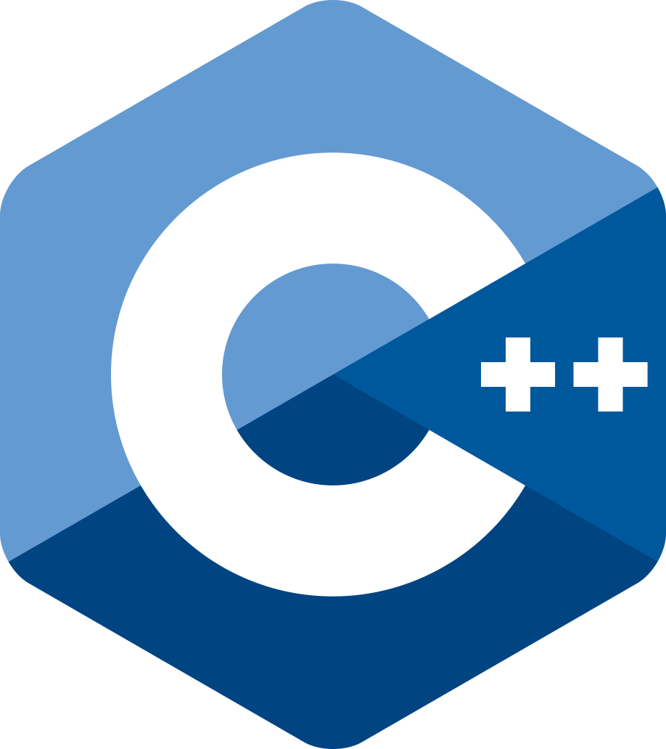







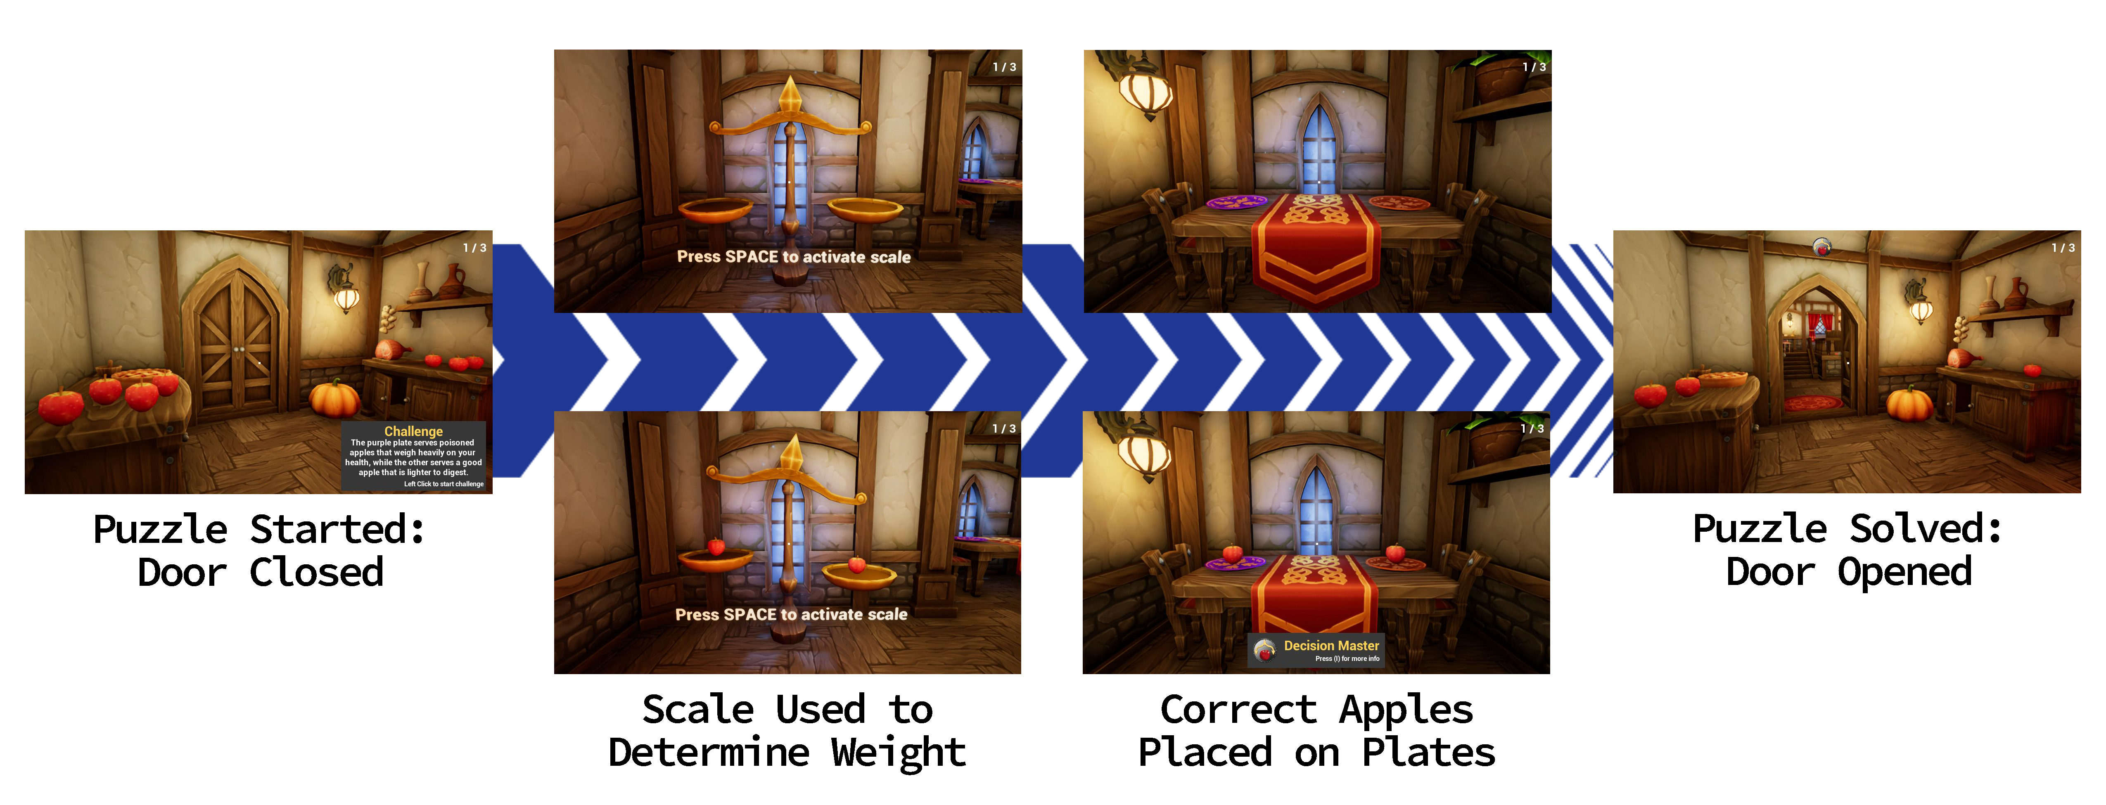
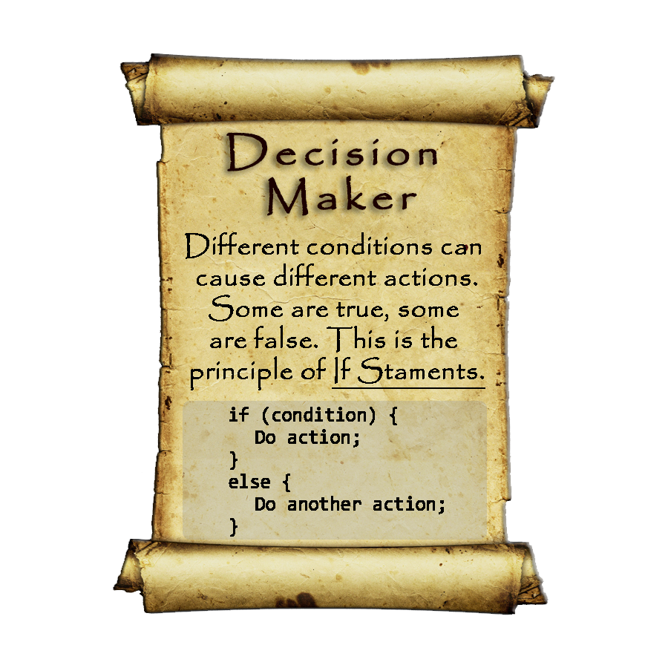
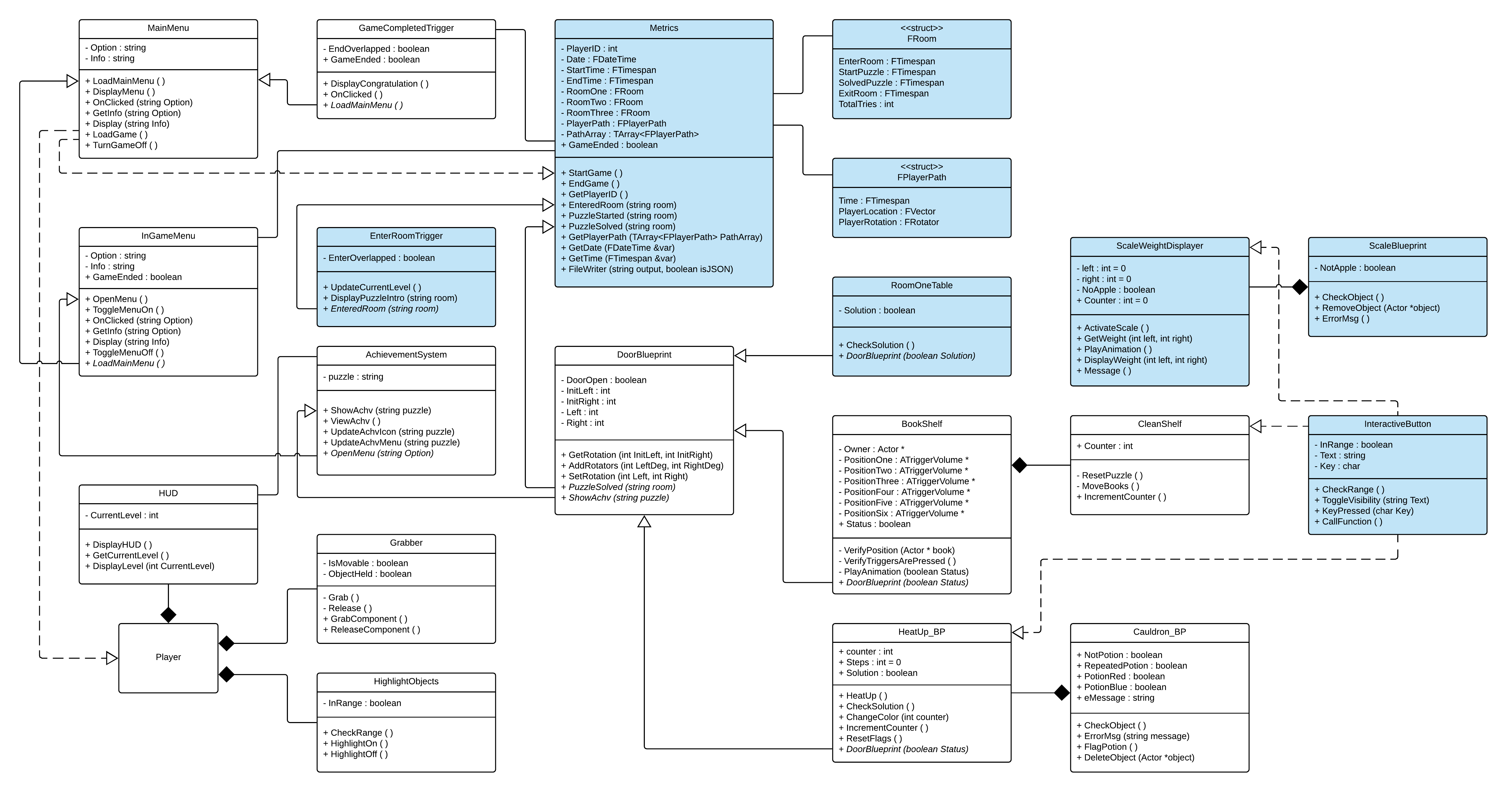
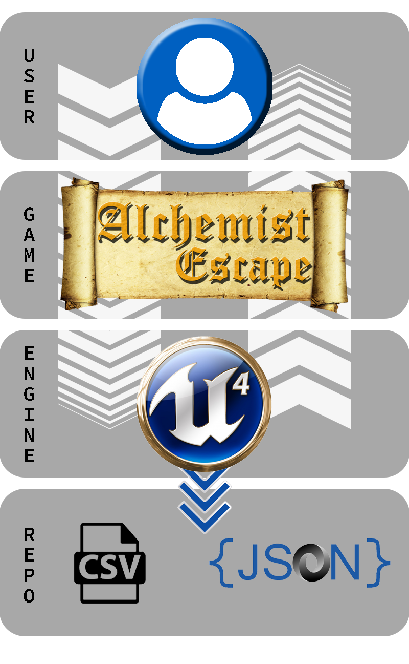
School of Computing & Information Sciences
VIP Senior Project, 2018, Spring
VR-Gaming to Broad Participation in CS 1.0
Student: Daniel Perez, Florida International University
Mentor: Francisco Ortega, Florida International University
Professor: Masoud Sadjadi, Florida International University
Problem
Current System
Solution
The computer science (CS) field is high in demand but there's a well-documented lack of gender and racial diversity. Women, Blacks and Hispanics are underrepresented in obtaining CS degrees. Educational institutions have attempted to make CS more appealing and accessible to these groups, yet the diversity gap endures.
Today’s games that focus on teaching CS concepts are either instructional or simulation based. These games are generating little interest and awareness in CS due to how they’re perceived.
Alchemist Escape is an escape the room themed video game designed to increase CS interest and awareness. Players learn about basic CS concepts by solving CS oriented puzzles which are disguised as simple tasks. This allows any player who has a misconception of CS to play the game, since no previous CS knowledge is required.
Screenshots
Implementation
Object Design
Unreal Engine 4 (UE4): Used to design and build the Alchemist Escape game. Blueprints and C++ were used to implement the logic for the game.
Visual Studio: IDE used for UE4 to write C++ scripts.
CSV and JSON: Used to store the data captured from the player metrics.
Blender: Used to create 3D models.
Photoshop: Used to create textures and images for the game.
Requirements
System Design
Summary
My contributions for Alchemist Escape:
Data Capture for Player Metrics
Export Data to JSON and CSV files
Logic for Calculating Weight on Scale
Logic for Scale Animation
Logic for Puzzle Completion
Logic for Interactive Button
Logic for Box Collisions
Puzzle Environment Creation
Testing and Debugging
The purpose of Alchemist Escape is to offer an entertaining game that increases CS interest and awareness. Players can learn about CS concepts through gameplay, without the need of having any CS knowledge.
Future work will include:
The addition of new rooms that would cover more complex CS concepts
Porting the game to mobile devices and other platforms to make the game more accessible to every demographic, in hopes of decreasing the diversity gap in CS
Acknowledgement
The material presented in this poster is based upon the work supported by Dr. Francisco Ortega. I am thankful to the help that I received from my group members, Santiago Bolivar & Armando Carrasquillo. I also thank my family and friends for all their support! FOLLOW US @FIUCIS
Notes:
1

